Slide 1

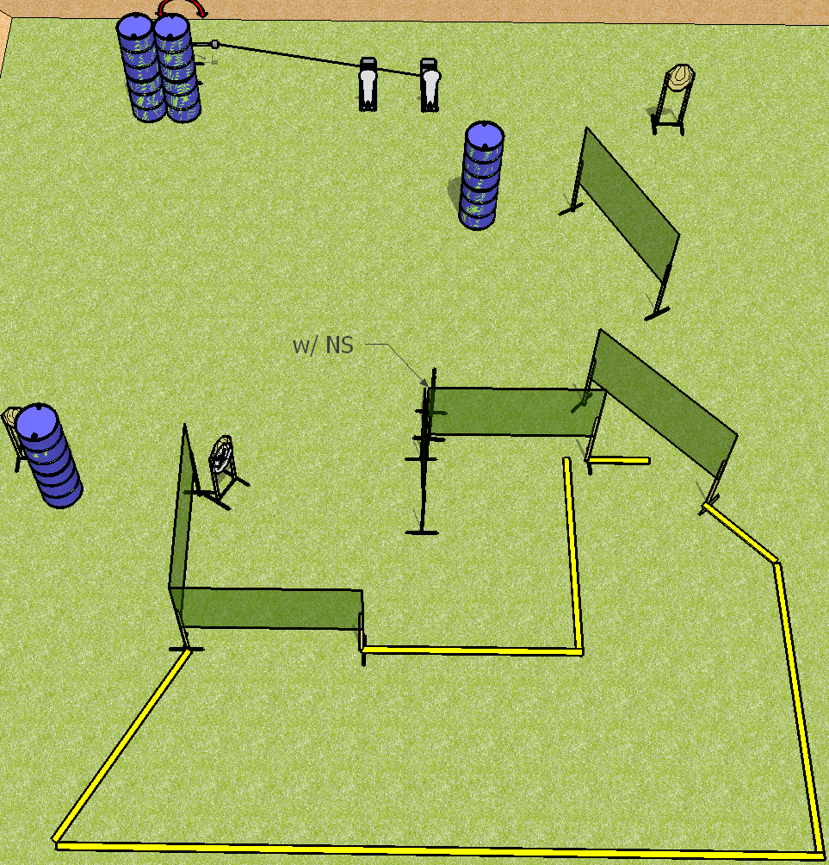
 | Dothan Practical Shooters – USPSA Match Outfield Rumble Course Designer : Drew Coleman Bay: B2
Round Count 12 rounds 5 IPSC 2 colt poppers
Equipment List 10 wall feet Swinger + activator 1 right diag 6 targets (4 + 2NS)

Slide 2
Outfield Rumble
Written Stage Briefing
Scoring: Comstock Rounds: 12
Targets: 5 IPSC, 2 steel
Handgun start position: anywhere completely outside the shooting area, wrists below belt. Handgun is loaded and holstered.
PCC start position: anywhere completely outside the shooting area, stock on belt. Loaded carbine is held with both hands, safety on.
Stage Procedure: on the audible start signal, engage targets as they become available from within the shooting area. The swinger is activated by either popper and remains visible at rest.

